Slide 1
Data Analytics: The Data Mining Process
Daniel L. Silver, PhD

Slide 2
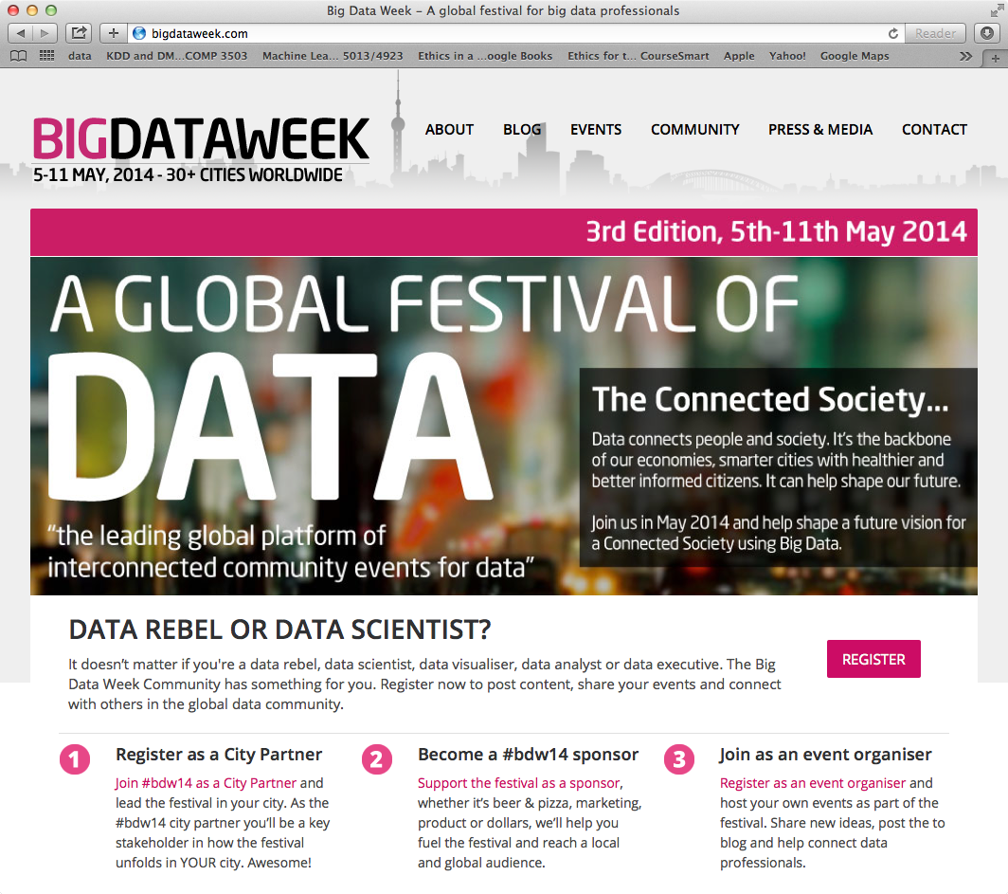

Slide 3
Outline
What is AIDA?
Data Analytics Overview
The Data Mining Process
Data Consolidation and Warehousing
Data Preparation
OLAP and Data Visualization
Predictive Modeling and Evaluation
Important Trends

Slide 4
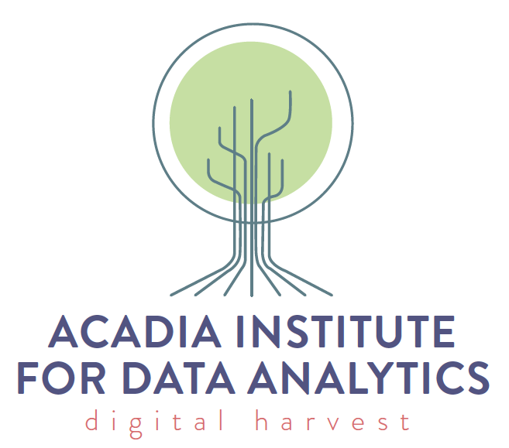
What is AIDA?
What:
An institute, not a research group
Who:
Danny Silver, Director
Wes Booth, Comm. & Events Coordinator
Where:
5th Floor Patterson Hall, Acadia University
When:
Since January, 2014

Slide 5
Why: AIDA’s Mission
To advance knowledge in data analytics through:
Collaborative and interdisciplinary research
Application and commercialization
Education and training
Promotion and outreach
To foster the ethical application and commercialization of data analytic solutions to challenges facing industry, government and society in rural Canada.

Slide 6
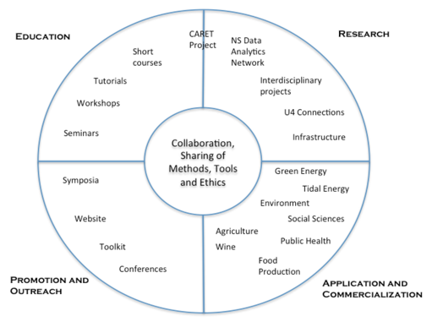
AIDA’s Objectives
Initial foci:
Agriculture
Agri-Food
Environment
Green energy

Slide 7
AIDA’s Mission
To advance knowledge in data analytics through:
Collaborative and interdisciplinary research
Application and commercialization
Education and training
Promotion and outreach
To foster the ethical application and commercialization of data analytic solutions to challenges facing industry, government and society in rural Canada.
The institute will initially focus on agriculture, agri-food, the environment, and green energy.

Slide 8
AIDA Objectives
Promotion and Outreach: To provide visibility for data analytics initiatives undertaken by members and communicate relevant events to industry, government and the public. To make the institute relevant to rural business and industry. To foster sharing of knowledge and use of data analytics through vehicles such as web inventories of member competencies and resources.
Research: To encourage, facilitate and leverage fundamental and interdisciplinary research and to attract high quality visiting scholars. To work with members to provide shared technical infrastructure for research and development where possible.
Education: To facilitate the development and delivery of educational programs such as short courses, training workshops, and seminars that are focused on the needs of members.
Application and Commercialization: To foster the development of innovative applications for use in academia, industry and government. To establish Nova Scotia as a leader in the application of data analytics to rural problems. To stimulate technology transfer, commercialization and the development of new startups.

Slide 9
Data Analytics for the Wine and Fruit Growing Industries
Date: March 29th, 2014 Time: 8:30 am – 1:00 pm Location: Acadia University, Clark Commons
Schedule: 8:30 am – Registration/Networking – Light Breakfast 9:00 am – Welcome and Introduction 9:10 am – 4 x 10 minute short talks (local practitioners) 10:10 am – Coffee, displays and networking 10:25 am – Keynote speaker 11:25 am – Panel discussion – DA for the wine & fruit growing sector 12:00 pm – Lunch/Networking
Sponsored by NS Department of Economic and Rural Development and Tourism (ERDT)

Slide 10
Data Analytics for the Wine and Fruit Growing Industries
Short Talks:
David Colville (Research Scientist, Applied Geomatics Research Group)
What Will Grow Where?: Mapping the Meteorological Landscape of Southwestern Nova Scotia
Angus Ells (Manager, Oxford Foods)
Developing a QGIS-based pest monitoring system for wild blueberries
Dr. Colin Bell (Biologist/Farmer - Windermere Hills Farm & Vineyard)
Grape Crown Gall in N.S.
Dr. Sean Myles (CRC, Faculty of Agriculture, Dalhousie University)
Data-driven apple breeding in the Annapolis Valley
Keynote Speaker:
Dr. Jim Willwerth (Senior Staff Scientist, CCOVI, Crock University)
Protecting vineyards using large data sets: VineAlert and monitoring cold tolerance in grapevines

Slide 11
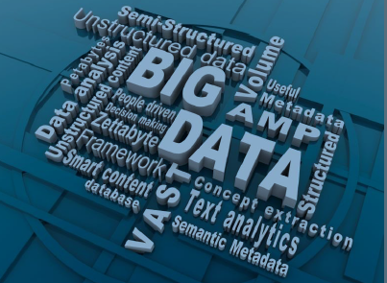
Data Analytics Overview

Slide 12
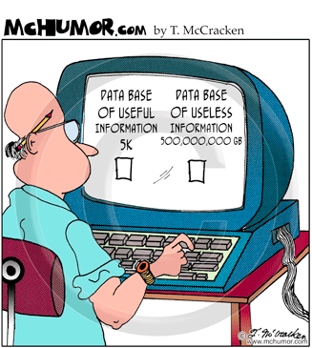
“We are drowning in information, but starving for knowledge.” John Naisbett Megatrends, 1988 Data Analytics
Not a new field:
Since 1990s: Data Analysis,
Knowledge Discovery,
Data Mining, Data Warehousing
A multidisciplinary field:
Database
Visualization
On-line Analytical Processing (OLAP)
Math and Statistics
Machine Learning
Notes:
Organizations gather considerable amounts of data on a daily basis:
Supermarket scanners Credit card readers
Automated bank tellers The internet
The volume of data defies manual efforts of analysis and summary (one estimate shows only 5 -7% of collected data are ever revisited)
A major challenge is how to convert expanding data stores into useful knowledge

Slide 13
Data Analytics Overview
What is Data Analytics?
A Process
Consolidating, inspecting, cleaning, transforming, and modeling data
Goal of discovering useful patterns, making predictions, and supporting decision making
Data Warehousing, Data mining, and Data Visualization are major components.

Slide 14
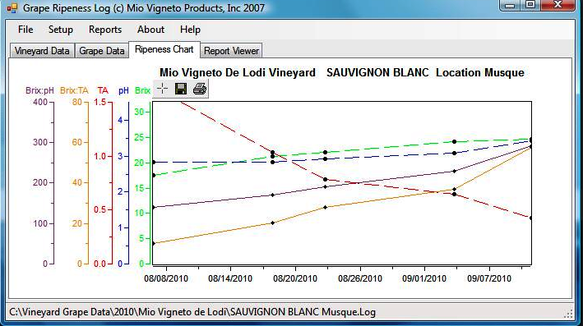
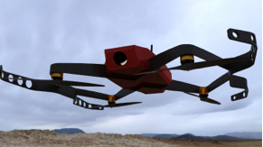
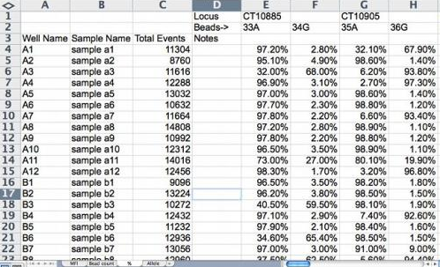
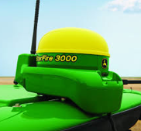
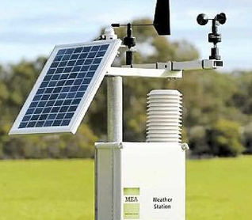
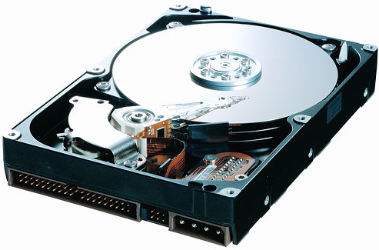
Data Analytics Overview
Knowledge
Data Mining
& Visualization
Data Preparation
Data Consolidation
and Warehousing

Slide 15
Data Analytics Overview
Why has DA become important?
Abundance of data → Big Data !!
Inexpensive, powerful computing systems
Strong theoretical/mathematical foundations
statistics and machine learning
database management systems
Competitive focus of organizations:
Business Intelligence, Knowledge Management

Slide 16
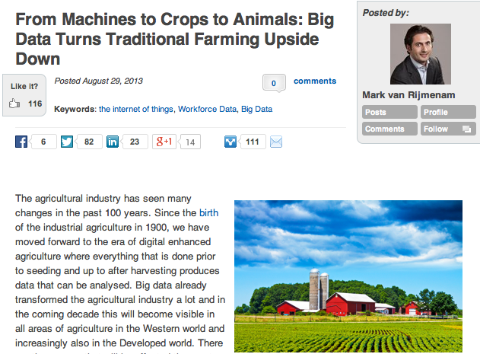
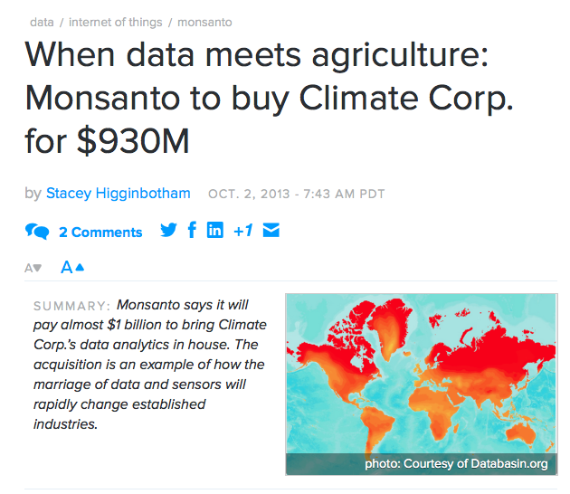
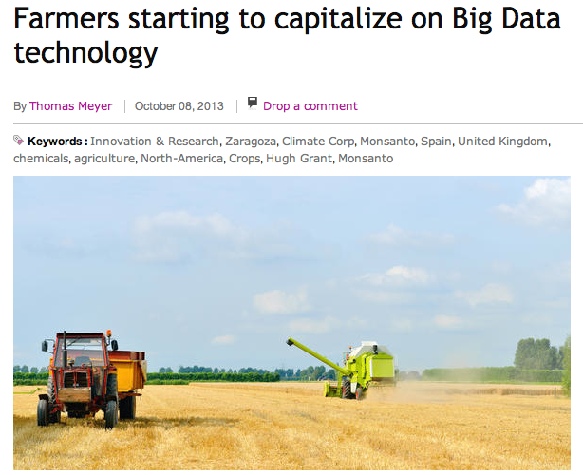
DA and Agriculture
informaecon.com July, 2013

Slide 17
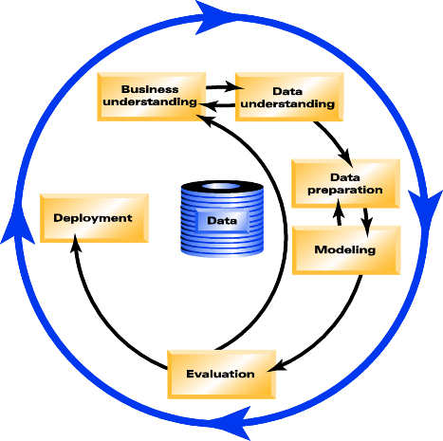
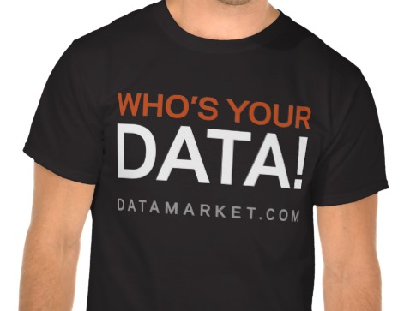
Business Intelligence/DA Cycle
Discover Knowledge
= Data Mining
Problem
Knowledge
Identify
Problem or
Opportunity
Act on
Knowledge
Measure Effect
of Action
Strategy
Results

Slide 18
Application Areas Private/Commercial Sector
Marketing: segmentation, targeted marketing, customer relationship management, ...
Finance: investment support, portfolio management
Banking & Insurance: credit and policy approval
Agriculture/Food: harvest forecasting, optimizing pesticide use, quality control (eggs, apples)
Science and medicine: hypothesis discovery, prediction, classification, diagnosis
Manufacturing: process modeling, quality control
Engineering: pattern recognition, signal processing
Environment: water quality, acquiver recharge models, erosion modeling, wastewater treatment control

Slide 19
Application Areas Public/Government Sector
Finance: investment management, price forecasting
Taxation: adaptive monitoring, fraud detection
Health care: medical diagnosis, risk assessment, cost /quality control
Education: process and quality modeling, resource forecasting
Insurance: worker’s compensation analysis
Security: bomb, iceberg detection
Transportation: simulation and analysis
Public Admin: demographic analysis, municipal planning

Slide 20
DA and Agriculture

Slide 21
The Data Mining Process
CRISP-DM
Method
CRoss
Industry
Standard
Process
for
Data
Mining
Developed by employees at SPSS, NCR, DaimlerCrysler

Slide 22
The CRISP-DM Method
Business Understanding:
Establish project objectives and requirements
Convert into a data mining problem definition
Consider model transparency, personal privacy, key input variables, various approaches
Define the success criteria
Create a detailed project plan.

Slide 23
The CRISP-DM Method
Data Understanding:
Identify internal and external sources of data
Discover insights into the data
Identify data quality problems
Detect interesting subsets of data
Create initial Meta Data Report (MDR) - Data about the data (syntax and semantics)

Slide 24
Data Consolidation & Warehousing
Garbage in Garbage out
The quality of results relates directly to quality of the data
50%-70% of DM process effort will be spent on data consolidation and preparation
Major justification for a Data Warehouse

Slide 25
Data Consolidation & Warehousing
From data sources to consolidated data repository
Analysis and
Info Sharing
Operational
DBMS
ETL = Extraction, Transformation, Loading
Data
Warehousing
Legacy
DBMS
Warehouse
or Datamart
Flat Files
Metadata flow
A clean, consistent and reliable source of organizational data
External

Slide 26
Data Warehousing
Definition: The strategic collection, cleansing, and consolidation of organizational data to meet operational, analytical, and communication needs.
75% of early DW projects were not completed
Data warehousing is not a project
It is an on-going set of organizational activities
Must be business benefits driven

Slide 27
Relationship between DW and DA
Strategic
Tactical
Rationale
for data
consolidation
Analytics
Data Mining
Data Visualization
Data
Warehousing
Source of
consolidated
data
Notes:
Need to get objectives of each participant.

Slide 28
The CRISP-DM Method
Data Preparation:
Construct dataset to be used for modeling
Select file/table, record, and attributes
Reduce attribute dimensionality
Reduce attribute range
Transform representation as needed
Multiple iterations with the modeling phase
Update MDR to reflect changes
Visualization tools can play key role

Slide 29
Data Preparation
Select set of examples
choose sampling method
consider sample complexity
deal with volume bias issues
Reduce attribute dimensionality
remove redundant and/or correlating attributes
combine attributes (sum, multiply, difference)
Reduce attribute value ranges
group symbolic discrete values
quantize continuous numeric values

Slide 30
Data Preparation
Transform data
decorrelate and normalize values
map time-series data to static representation
Encode data
representation must be appropriately for the Data Mining tool which will be used
continue to reduce attribute dimensionality where possible without loss of information
OLAP and Visualization tools can play key role

Slide 31
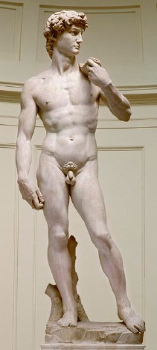
Data Visualization
Graphical representation of data
View of relationships between data
The right abstraction of the data
Allows us to explore the data
Communicates – Informative
Elegant - Simple
Aesthetically pleasing
[slide courtesy of Stan Matwin]

Slide 32
OLAP: On-Line Analytical Processing
Metrics: count,
average size, quality
OLAP Functionality
Dimension selection
slice & dice
Rotation
allows change in perspective
Filtration
value range selection
Navigate hierarchies
drill-downs to lower levels
roll-ups to higher levels
Location
(region,
soil type)
OLAP
cube
Time
(day of year,
hour)
Produce
(variety, name)

Slide 33
OLAP: On-Line Analytical Processing
OLAP Functionality
Dimension selection
slice & dice
Rotation
allows change in perspective
Filtration
value range selection
Navigate hierarchies
drill-downs to lower levels
roll-ups to higher levels
Profit Values
Sales
Region
OLAP
cube
Year
by Month
Product Class
by Product Name

Slide 34
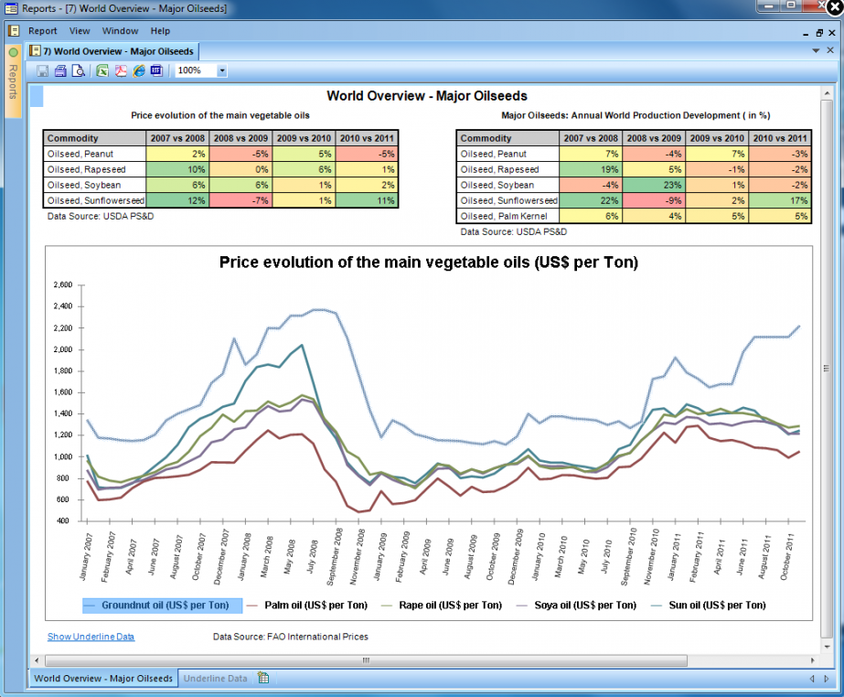
OLAP: On-Line Analytical Processing
Simple
Example

Slide 35
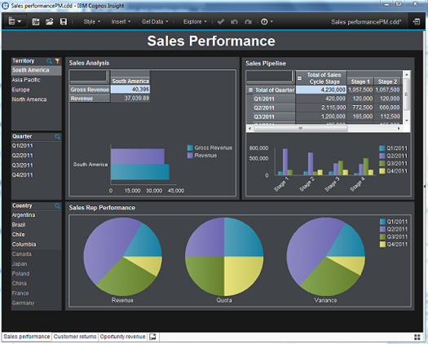
OLAP: On-Line Analytical Processing
IBM
Cognos
Insight

Slide 36
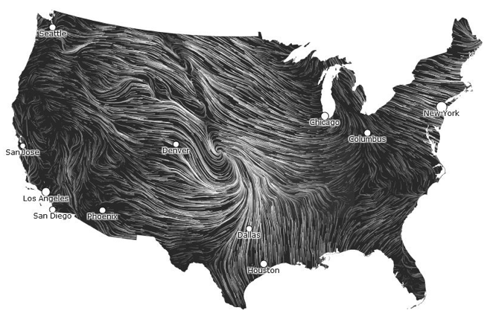
Wind Map - Animation
Source: http://hint.fm/wind/ [Martin Wattenberg]
Data from the National Digital Forecast Database

Slide 37
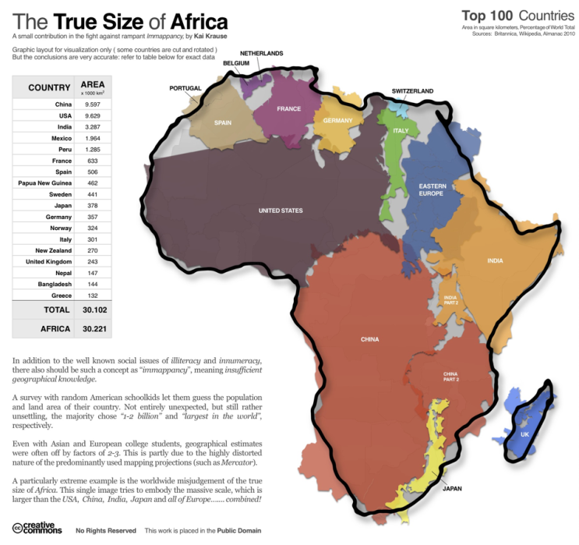
Ture Size of Africa
Source: http://flowingdata.com/2010/10/18/true-size-of-africa/ [Kai Kruse]

Slide 38
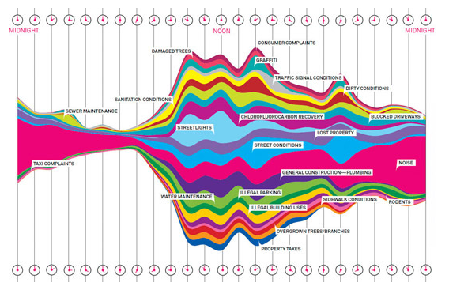
What New Yorkers Complain About
Source: Wired - NY 311, 50,000 calls a day

Slide 39
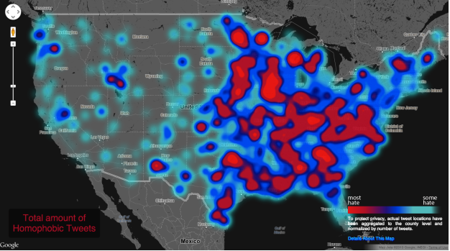
Visualizing Social Media Geography of Hate
Source: http://users.humboldt.edu/mstephens/hate/hate_map.html#

Slide 40
The CRISP-DM Method
Modeling:
Select and apply modeling techniques
Some techniques may require additional data preparation
Optimize model parameters for best models
Multiple iterations through the Data Preparation and Modeling phases

Slide 41
Overview of Data Mining Methods
Automated Exploration/Discovery
e.g.. discovering new market segments
distance and probabilistic clustering algorithms
Prediction/Classification
e.g.. forecasting gross sales given current factors
regression, neural networks, genetic algorithms
Explanation/Description
e.g.. characterizing customers by demographics and purchase history
inductive decision trees, association rule systems
Age
Income
$(x)
x
if age > 35
and income < $35k
then ...
Notes:
At the university, the corporate sponsors and within the greater business community ...
Research
Investigate and advance state-of-the art KDD technologies and processes and their application to marketing information
Application
Identify problems and apply appropriate KDD technologies and processes
Facilitate project management though the transfer of success factors
Promotion and Resource
Act as a catalyst and resource on KDD
Publish research and case study results
Establish Atlantic Canada as a leader
Education
Develop and deliver KDD seminar material at the academic and industry level

Slide 42
Data Mining Methods
Prediction and Classification
Function approximation (curve fitting)
Classification (pattern recognition)
Methods:
Statistical regression
Artificial neural networks
Inductive decision trees
Nearest neighbour algorithms
Support vector machines
f(x)
x
A
B
x2
x1
O1
O2
I1
I2
I3
I4

Slide 43
Classification
1
Y
Logistic Regression
0
Y=f(A,I)
Y
B
B
B
B
B
B
B
B
B
B
A
I
B
A
B
A
B
B
B
B
B
A
Age
(years)
B
A
B
B
A
A
B
A
B
A
A
B
B
B
B
A
A
A
A
A
A
B
A
A
B
A
A
B
A
Income ($)

Slide 44
Classification
Artificial Neural Network
Y
B
B
B
…
B
B
B
B
B
B
B
B
A
B
A
B
B
A
I
B
B
B
A
Age
(years)
B
A
B
B
A
A
B
A
B
A
A
B
B
B
B
A
A
A
A
A
A
B
A
A
A
B
A
A
B
A
Income ($)

Slide 45
Classification
Root
A?
A?
I?
Inductive Decision Tree
B
A
Leaf
B
B
B
B
B
B
B
B
B
B
B
A
B
A
B
B
B
B
B
A
Age
(years)
B
A
B
B
A
A
B
A
B
A
A
B
B
B
B
A
A
A
A
A
A
B
A
A
A
B
A
A
B
A
Income ($)

Slide 46
The CRISP-DM Method
Evaluation/Interpretation:
Evaluate models against the success criteria using independent data sets (generalization)
Analyse and interpret model for new found knowledge
Decide on the use of model/knowledge/results

Slide 47
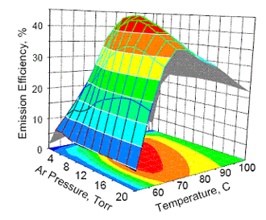
Interpretation and Evaluation
Visualization tools helpful here as well:
sensitivity analysis (I/O relationship)
histograms of value distributions
time-series plots and animation
requires training and practice

Slide 48
The CRISP-DM Method
Deployment:
Use of models/knowledge can vary …
As simple as generating a project report
As complex as implementing a repeatable data mining system that is integrate into a larger business process.

Slide 49
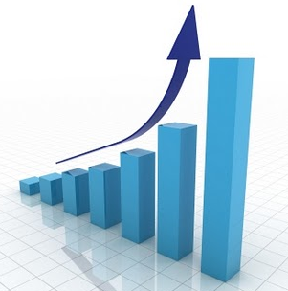
Important Trends
Notes:
Organizations gather considerable amounts of data on a daily basis:
Supermarket scanners Credit card readers
Automated bank tellers The internet
The volume of data defies manual efforts of analysis and summary (one estimate shows only 5 -7% of collected data are ever revisited)
A major challenge is how to convert expanding data stores into useful knowledge

Slide 50
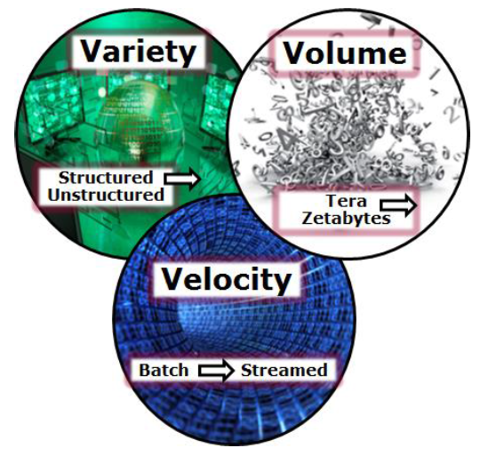
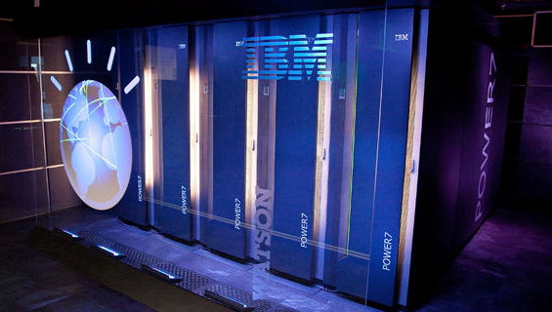
What makes Big Data – “Big”
Mobile, Real-time
Delivery
Data Capture Technology
High Performance Computing

Slide 51
10 Trends for 2014-15
Investment in big data analytics on the rise (Chief Data Officers)
Collection and analysis of mobile device data increasing
Age of Context / Internet of Things - personal activity monitors
Predictive Analytics to take center stage
Data visualization ➔ fosters a strong data analysis culture
Hadoop-based reliable HPC will gain stature
Analytics in the Cloud (Amazon Web Services, Microsoft Azure) enables scalable, fast, secure, cheap solutions
Smarter apps that use personal data and improve with experience
Use of unstructured internal and external (social media) will grow
Data privacy and security concerns will grow

Slide 52
10 Trends for 2014-15
Investment in big data analytics on the rise (Chief Data Officers)
Collection and analysis of mobile device data increasing
Age of Context / Internet of Things - personal activity monitors
Predictive Analytics to take center stage
Data visualization ➔ fosters a strong data analysis culture
Hadoop-based reliable HPC will gain stature
Analytics in the Cloud (Amazon Web Services, Microsoft Azure) enables scalable, fast, secure, cheap solutions
Smarter apps that use personal data and improve with experience
Use of unstructured internal and external (social media) will grow
Data privacy and security concerns will grow

Slide 53
Big Data Analytics Global Outlook
Business exceeded $31B in 2013.
Expect to reach $114B in 2018 [ABIreseach]
Investing or planning to invest in Big Data : 58% (2012) ➔ 64% (2013) [Gartner]
91% Fortune 1000 companies have Big Data plans [New Vantage Partners, 2013]
[source] http://www.yellowfinbi.com/YFCommunityNews-If-the-benefits-of-Big-Data-Analytics-are-indisputable-why-are-many-struggling-t-151123

Slide 54
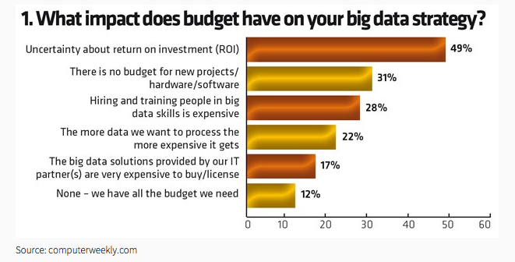
But Organizations Feel Overwhelmed
Notes:
A recent Bain & Company study, examining more than 400 large organizations with Big Data aspirations, found that only 23% had a clear strategy for effectively using Big Data Analytics. Only 18% of respondents to the abovementioned CompTIA survey agreed that they were “exactly where they wanted to be in managing and using data”.

Slide 55
10 Trends for 2014-15
Investment in big data analytics on the rise (Chief Data Officers)
Collection and analysis of mobile device data increasing
Age of Context / Internet of Things - personal activity monitors
Predictive Analytics to take center stage
Data visualization ➔ fosters a strong data analysis culture
Hadoop-based reliable HPC will gain stature
Analytics in the Cloud (Amazon Web Services, Microsoft Azure) enables scalable, fast, secure, cheap solutions
Smarter apps that use personal data and improve with experience
Use of unstructured internal and external (social media) will grow
Data privacy and security concerns will grow

Slide 56
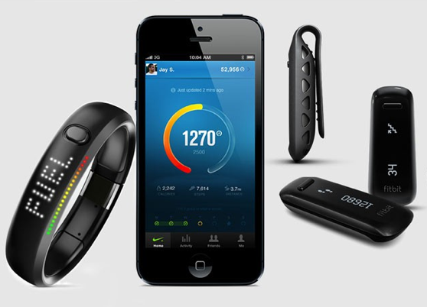
Age of Context / Internet of Things

Slide 57
10 Trends for 2014-15
Investment in big data analytics on the rise (Chief Data Officers)
Collection and analysis of mobile device data increasing
Age of Context / Internet of Things - personal activity monitors
Predictive Analytics to take center stage
Data visualization ➔ fosters a strong data analysis culture
Hadoop-based reliable HPC will gain stature
Analytics in the Cloud (Amazon Web Services, Microsoft Azure) enables scalable, fast, secure, cheap solutions
Smarter apps that use personal data and improve with experience
Use of unstructured internal and external (social media) will grow
Data privacy and security concerns will grow

Slide 58
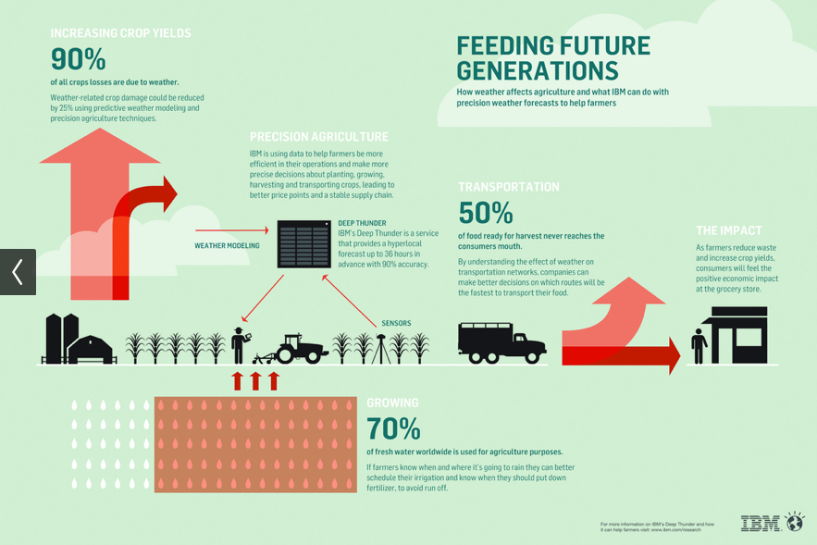
Predictive Weather Analytics

Slide 59
10 Trends for 2014-15
Investment in big data analytics on the rise (Chief Data Officers)
Collection and analysis of mobile device data increasing
Age of Context / Internet of Things - personal activity monitors
Predictive Analytics to take center stage
Data visualization ➔ fosters a strong data analysis culture
Hadoop-based reliable HPC will gain stature
Analytics in the Cloud (Amazon Web Services, Microsoft Azure) enables scalable, fast, secure, cheap solutions
Smarter apps that use personal data and improve with experience
Use of unstructured internal and external (social media) will grow
Data privacy and security concerns will grow

Slide 60
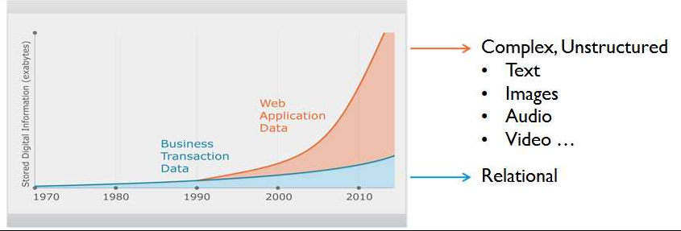
Growth of Unstructured Data
80% of Data is Unstructured
Much is text based:
Business data
Call center transcripts
Other CRM
Email
Web pages
News Groups
Admin. documents
Regulatory information

Slide 61
10 Trends for 2014-15
Investment in big data analytics on the rise (Chief Data Officers)
Collection and analysis of mobile device data increasing
Age of Context / Internet of Things - personal activity monitors
Predictive Analytics to take center stage
Data visualization ➔ fosters a strong data analysis culture
Hadoop-based reliable HPC will gain stature
Analytics in the Cloud (Amazon Web Services, Microsoft Azure) enables scalable, fast, secure, cheap solutions
Smarter apps that use personal data and improve with experience
Use of unstructured internal and external (social media) will grow
Data privacy and security concerns will grow

Slide 62
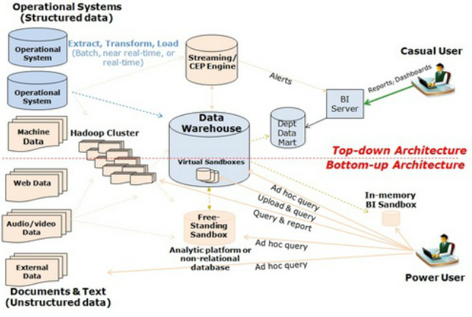
Top-Down – traditional DA Architecture Bottom-up – Big DA Architecture

Slide 63
10 Trends for 2014-15
Investment in big data analytics on the rise (Chief Data Officers)
Collection and analysis of mobile device data increasing
Age of Context / Internet of Things - personal activity monitors
Predictive Analytics to take center stage
Data visualization ➔ fosters a strong data analysis culture
Hadoop-based reliable HPC will gain stature
Analytics in the Cloud (Amazon Web Services, Microsoft Azure) enables scalable, fast, secure, cheap solutions
Smarter apps that use personal data and improve with experience
Use of unstructured internal and external (social media) will grow
Data privacy and security concerns will grow

Slide 64
Security and Privacy Issues
Ownership of data
Responsibility for accuracy of data
Ethical practices - fair use of data
Security of data

Slide 65
Questions? danny.silver@acadiau.ca

